Slide 1
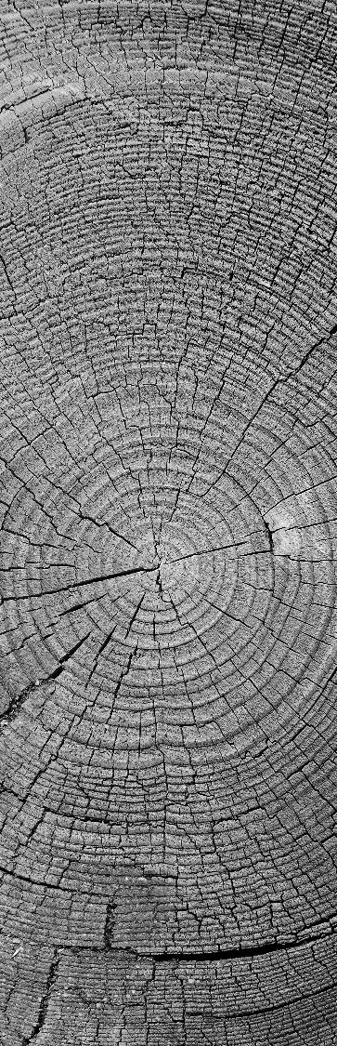
Visualize & analyze energy data
IoT ANALYTICS
Power Management in
Smart Homes
By STEVEN MELENDEZ

Slide 2
Project goals
Power Management in
Smart Homes

Slide 3

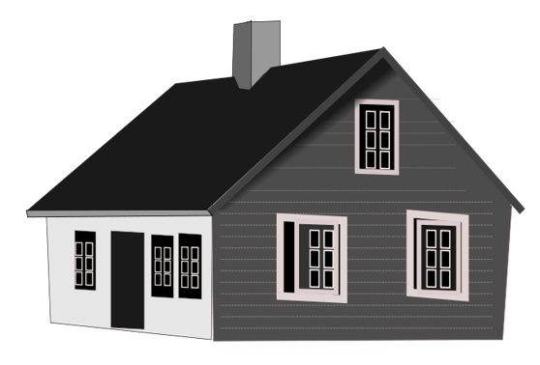



OBJECTIVES
High Level Objective: Determine if the installation of sub-metering devices that measure power consumption can translate into economic incentive recommendations for homeowners.
A – Determine if sub-metered data provides enough granularity to uncover trends in behavior or appliance performance.
B - Identification of peak energy usage to determine the best off-peak electricity rates.
C – Identify longer-term patterns of energy usage that can be used to predict future usage.
4

Slide 4
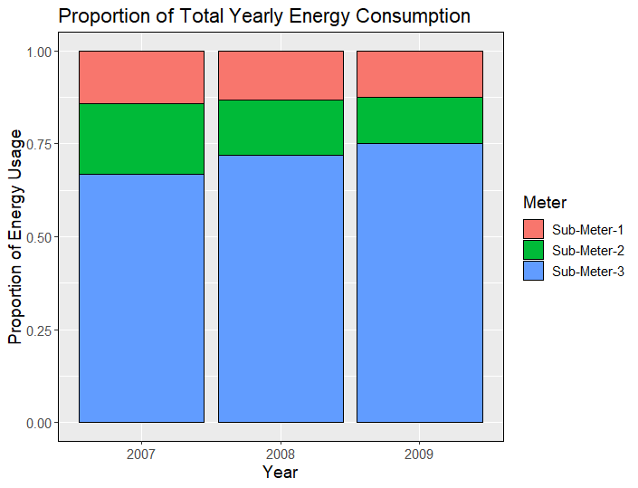
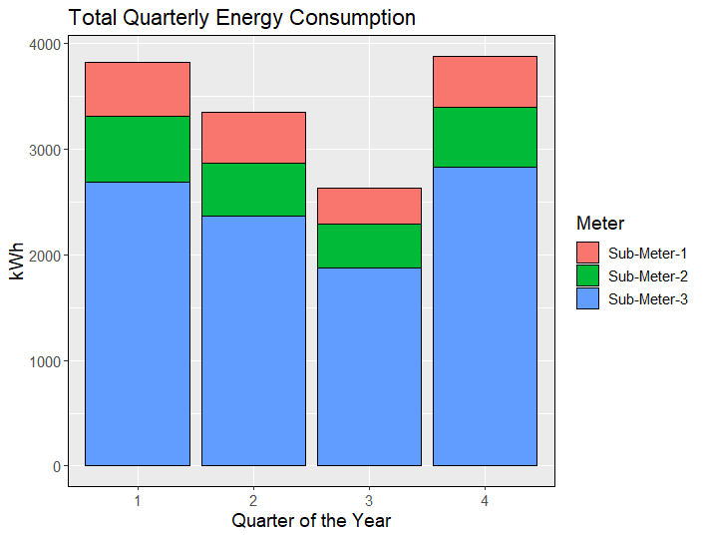
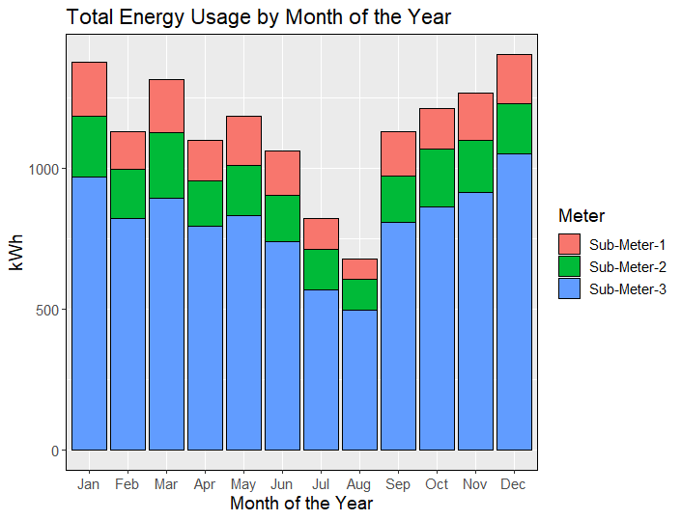
Visualizations by year, quarter and month
There is a clear trend of increasing energy consumption on sub-meter-3 (electric water heater/ air conditioner).
A trend such as this could indicate erosion of performance of an appliance which would have to run longer and/or more frequently to maintain a temperature set point.
Looking at total energy consumption by quarter over the 2007-2009 timeframe shows a clear trend of decreasing energy usage with a trough in Q3 and rebounding in Q4
The same pattern of energy consumption is observed in the quarterly data.

Slide 5

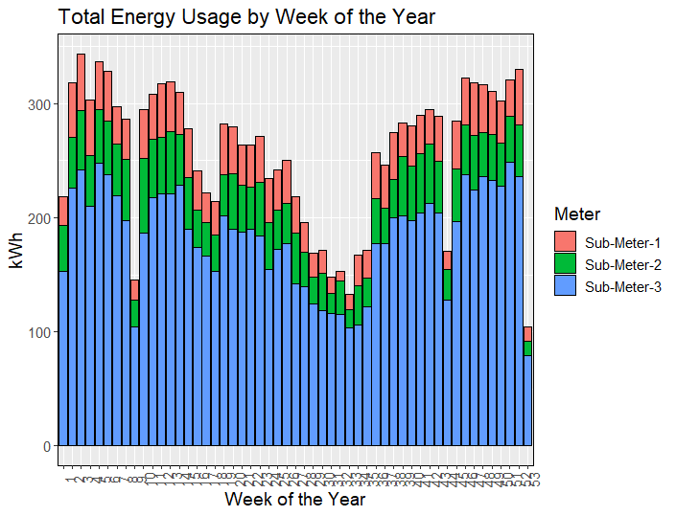
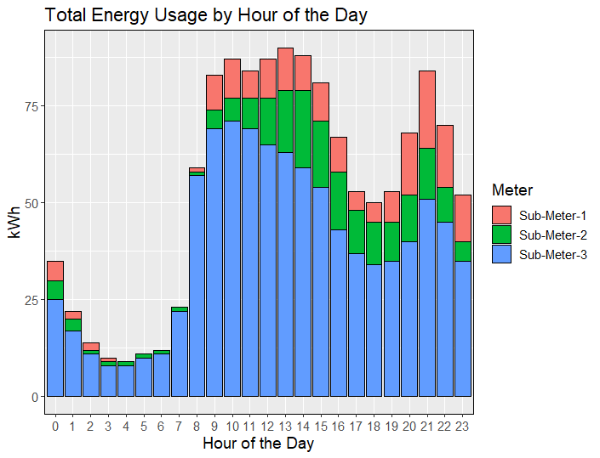
Visualizations by week and hours
An additional patterns of energy consumption become apparent when looking at energy usage by week of the year, a recurring pattern of noticeably lower energy consumption occurs roughly every 8 or 9 weeks starting with week 1.
Drilling down to the hour level, another patter in found, the lowest energy usage is in the early morning hours where all sub-meters reach their minimum

Slide 6
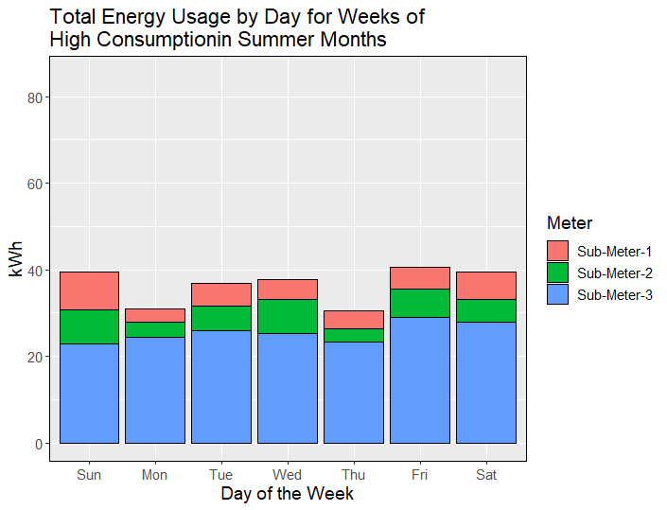
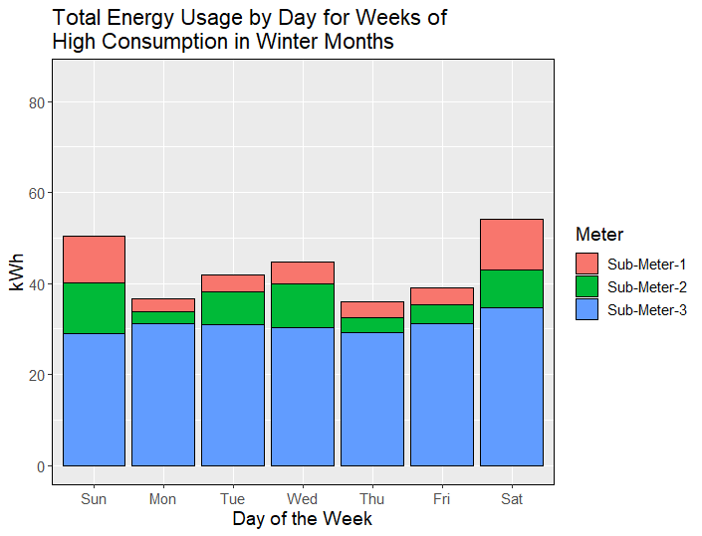
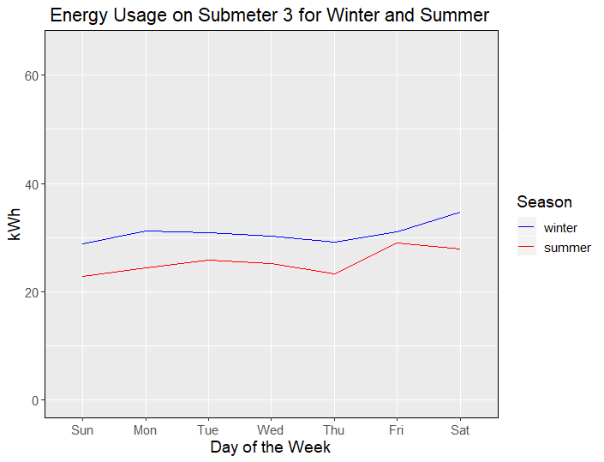
Visualizations by winter & summer months
Total consumption on submeter 3 is less in the summer months than in the winter months. Submeter 3 monitors AC and water heater. This suggests that the increase in consumption in the winter as measured by submeter 3 may be due to a poorly insulated water heater or a water heater in a poorly insulated space
There is a trend of increasing energy usage on sub-meter 3 as the week progresses. Peak kitchen usage seems to happen on the weekends (sub-meter 1) while peak laundry days appears to be on Saturday, Sunday and Wednesday (sub-meter 2). It seems energy usage of submeter 3 is driven by the electric water heater and not the air conditioner, since data is from winter.
Submeter 3 shows a similar pattern in terms of consumption during winter and summer days, therefore potential actionable insights can be uncovered in energy data for this submeter.

Slide 7
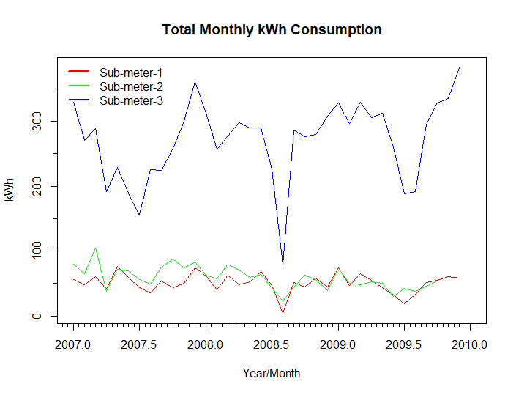
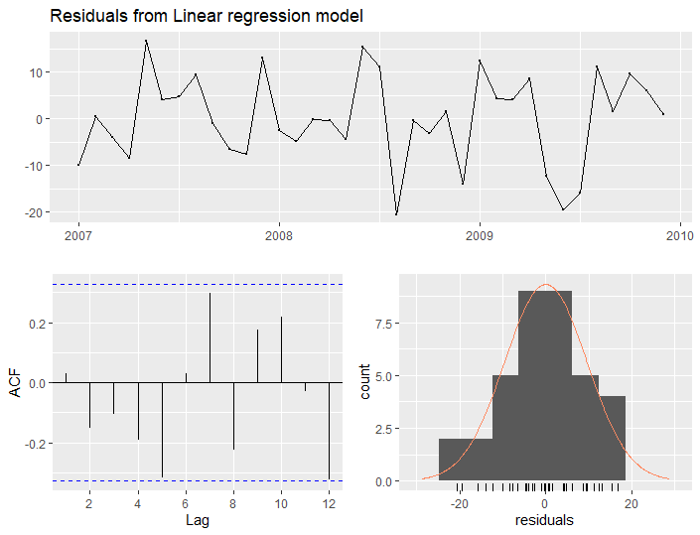
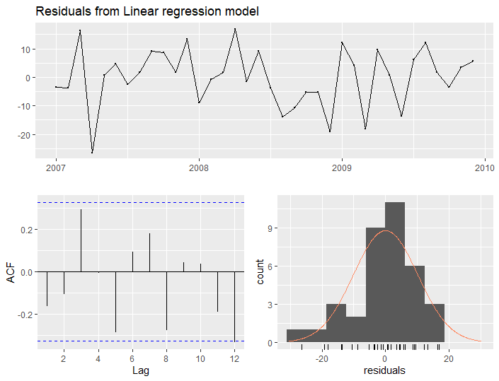
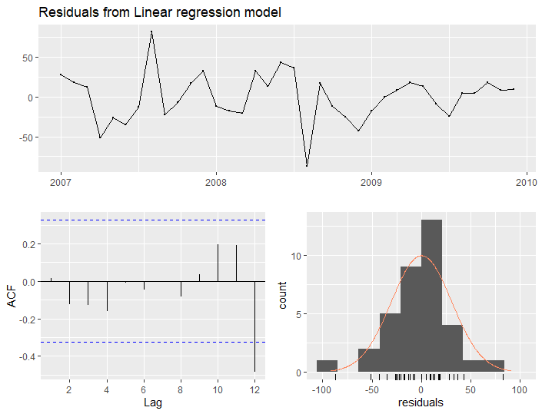
Time series visualizations
The distribution of the residuals is shown in the bottom right histogram. This is a nice example of a normal distribution that’s centered around zero which is what we would expect for a linear regression model that fits the data well.
The result of the autocorrelation test conducted with the Breusch-Godfrey test which tests for autocorrelation. The resulting p-value in all submeters is above the 0.05 threshold so we cannot reject the null hypothesis which states that there is no autocorrelation.
We can see a seasonal pattern over the years with trough of energy usage in the summer that is most-pronounced with submeter 3
Sub Meter | LM Test | p-Value
1 | 24.348 | 0.082
2 | 19.748 | 0.231
3 | 19.389 | 0.249

Slide 8
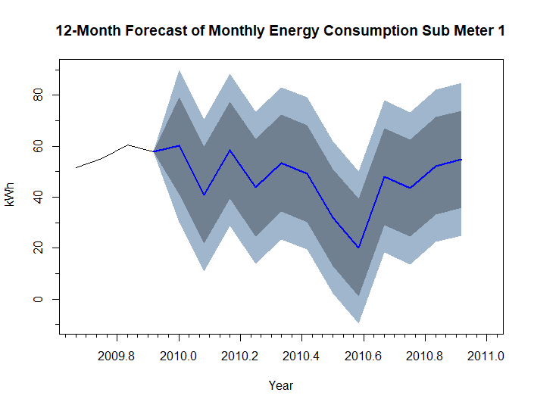
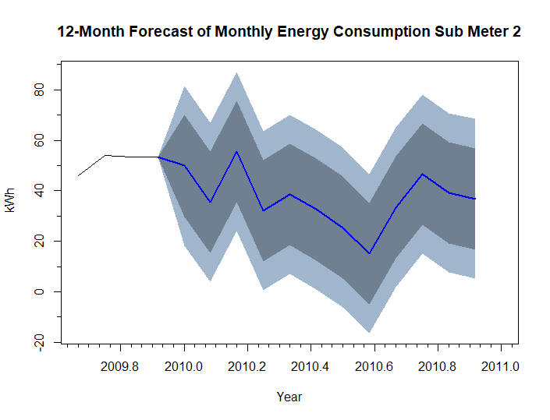
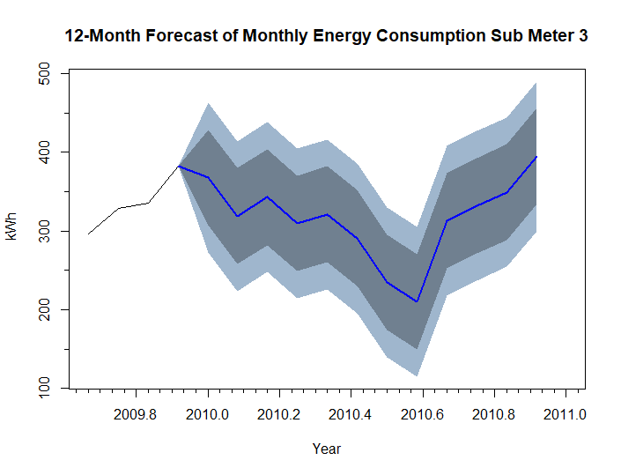
Linear regression forecast
Sub Meter | RMSE | R-squared | p-Value
1 | 9.43 | 0.36 | 0.0218
2 | 9.96 | 0.47 | 0.0041
3 | 30.04 | 0.62 | 0.0001
Prediction for all sub meters were conducted within confidence intervals in the range of 80 – 95%.

Slide 9
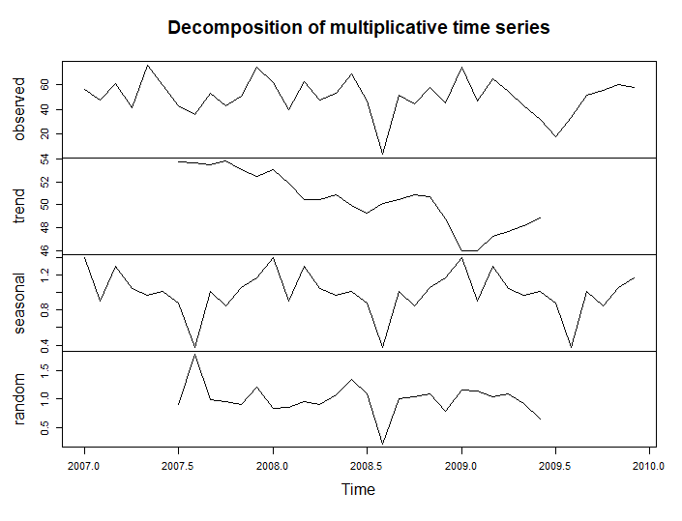
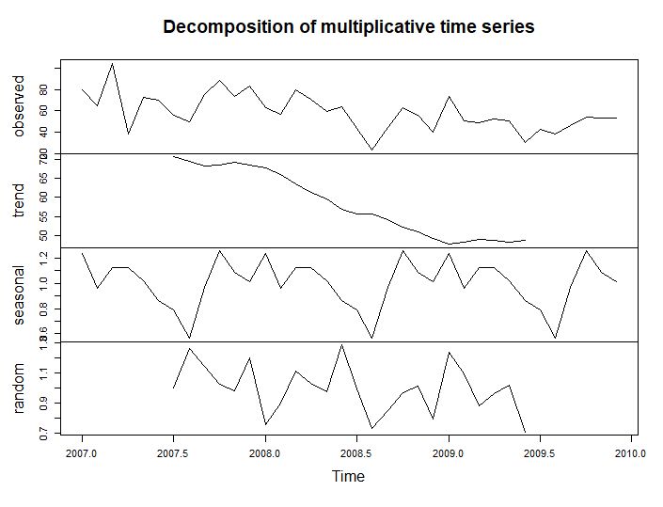
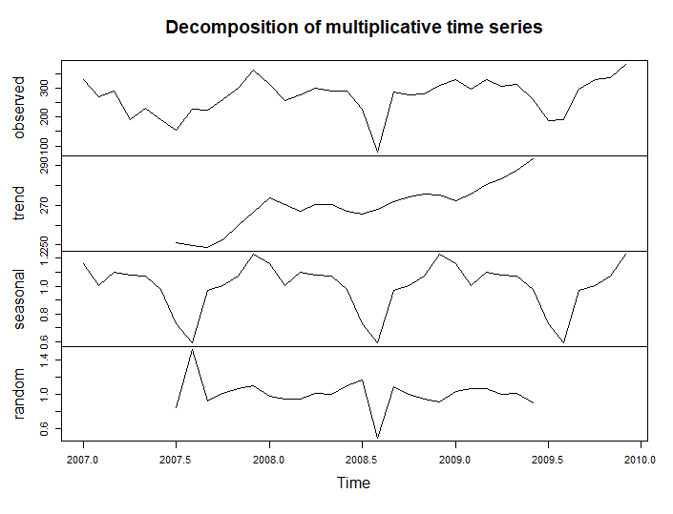
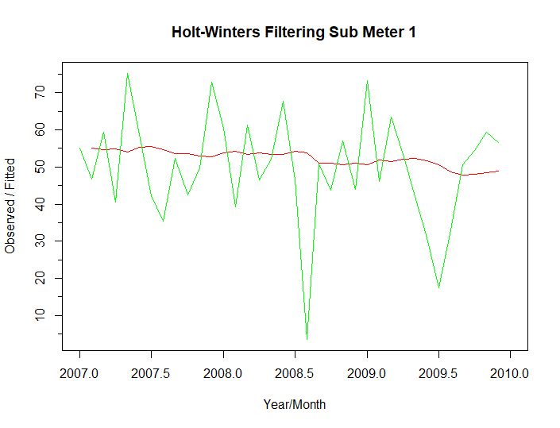
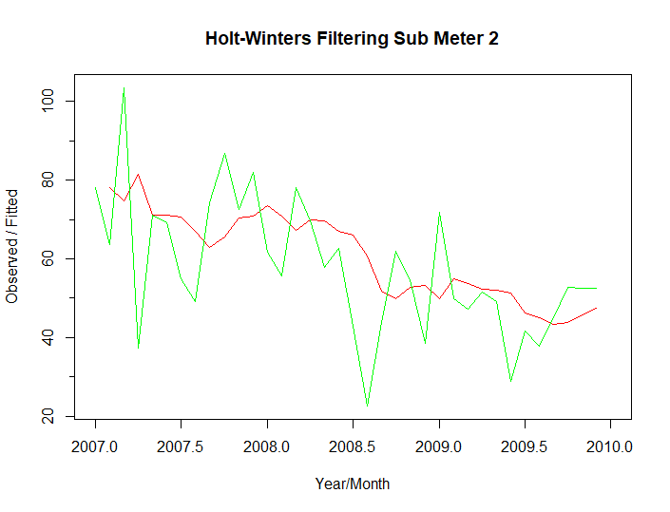
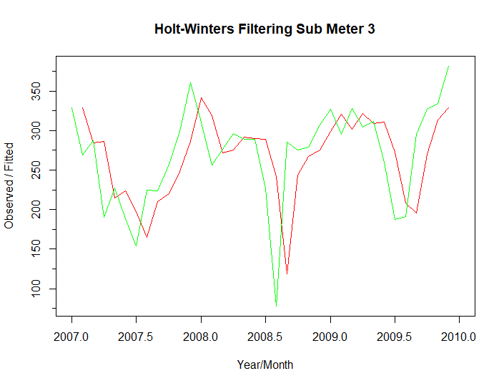
Decomposition visualizations
Time Series were decomposed to subtract the seasonality (Figures above). The 3 figures below, shows the holt-winters filtering in red color for submeters 1, 2 and 3. The red line are the new data sets without the seasonality effect.

Slide 10
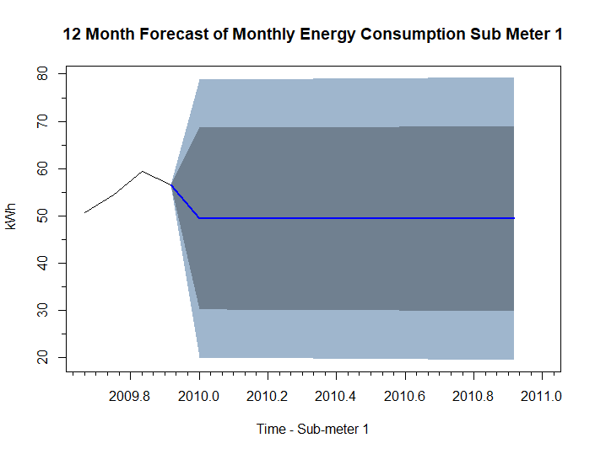
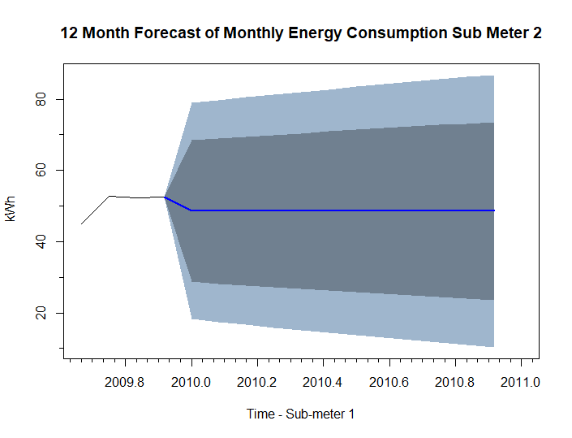
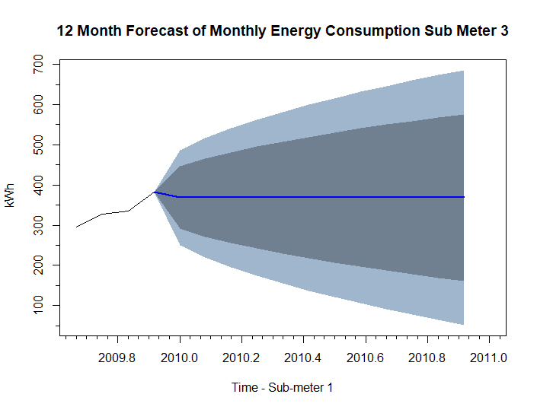
Holt-winters forecast
Sub Meter | RMSE LR | RMSE HW
1 | 9.43 | 15.07
2 | 9.96 | 15.69
3 | 30.04 | 59.54
Holt-Winters has better RMSE values, therefore the predictions with this method has a higher accurary compared with linear regression.

Slide 11
Summary / Conclusions
All objectives defined in the objective section were successfully meet, five business recommendations were provided to insure the best use of the sub-metering technology.
Objective 1 - Determine if sub-metered data provides enough granularity to uncover trends in behavior or appliance performance.
This was demonstrated through the analysis of several time periods. For example, looking at energy consumption on days of the week during winter months, we were able to determine that the kitchen was used the most on weekends while laundry days were most commonly Sunday and Wednesday.
On a less granular level, the quarterly and monthly plots of energy usage showed a noticeable trough in the summer months. Finally, an interesting insight was uncovered with regards to trends of usage and appliance performance when comparing high energy usage on submeter 3 (air conditioner/electric water heater) during winter and summer time periods.
Energy consumption was similar in winter and summer months, a higher granular level is required to uncover the appliance driving the power consumption.

Slide 12
Summary / Conclusions
Objective 3 - Identify longer-term patterns of energy usage that can be used to predict future usage.
While looking at historical trends in energy consumption can flag unusual behavior of an appliance, deviations from predicted energy usage would be a more proactive way to identify unusual behavior of an appliance.
Regression models were fit to monthly time series data and future energy consumption was predicted. Actual energy consumption that fell outside of a predicted interval could alert the homeowner to a potential issue with an appliance.
Objective 2 - Identification of peak energy usage to determine the best off-peak electricity rates.
Drilling down to energy consumption by hour of the day showed noticeable periods of peak and low usage.
This insight provides an opportunity for cost savings if the electric company offers peak and off-peak rates. For instance, timers on the washer machine and/or the dishwasher could be used to take advantage of off-peak rates.

Slide 13
recommendations
Since sub-meter 3 accounts for most of the sub-metered energy consumption, a homeowner would likely find value in knowing how the water heater and air conditioner contribute to that total.
If it is determined that the local electricity provider offers off-peak rates, a timer on the washer machine and/or the dishwasher could be set to run after midnight.
Require separate sub-meters for high energy consuming appliances, to determine the cost driver appliances.
Since weather conditions or sport activities can drive energy consumption, an aggregation of this data can be beneficial to determine abnormal peaks of energy consumption.
Create use cases to help homeowners to visualize sub-metering benefits.

Slide 14
Lessons learned
Time management - In-depth analysis of time series theory was necessary to conduct this exercise (40 hours of time was required to developed this exercise)
Data Sets - Gather data sets with full year data, this will create a larger data set to conduct the exercise.
Resources – Data camp resources were used to understand the topic
Examples – Several examples from different authors were used to developed this analysis

